Slide 1
BRANCH -ECE
SEMESTER-6th
ANTENNA ENGINEERING

Slide 2
Table of contents
01
Principles of Radiation
02
Types of Antennas
03
Horn Antennas
04
Microstrip Antenna

Slide 3
01
Principles of Radiation

Slide 4
TO DISCUSS
Principles of Radiation, Retarded Vector Magnetic Potential. Radiation field from Current element. Radiation Resistance, Current Distribution, on a thin Wire.
Half wave dipole and Quarter wave monopole. Two-element array. Principle of Pattern Multiplication.
Linear Array. Broadside and end fire patterns. Antenna Gain, effective length of an antenna. Input Impedance. Balun.

Slide 5
, Retarded Vector Magnetic Potential.

Slide 9
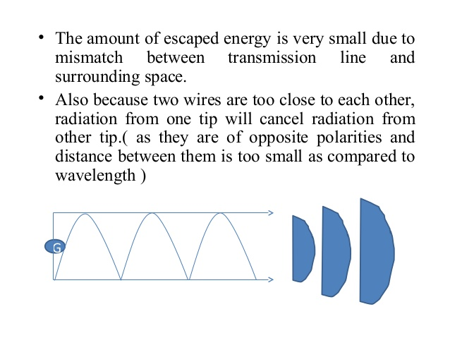

Slide 10
\

Slide 11
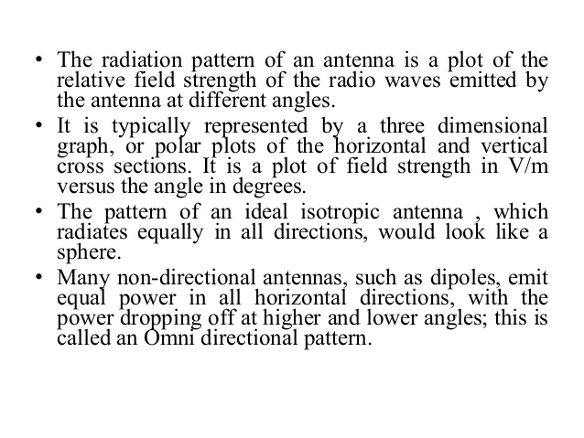

Slide 13
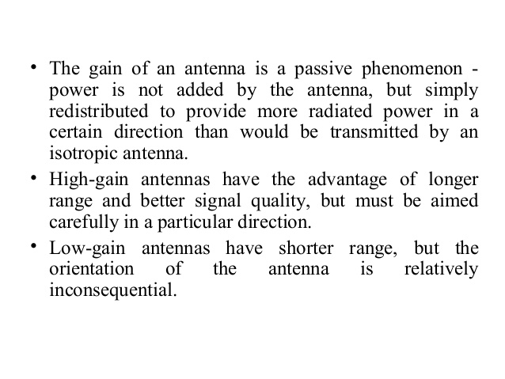
.

Slide 17
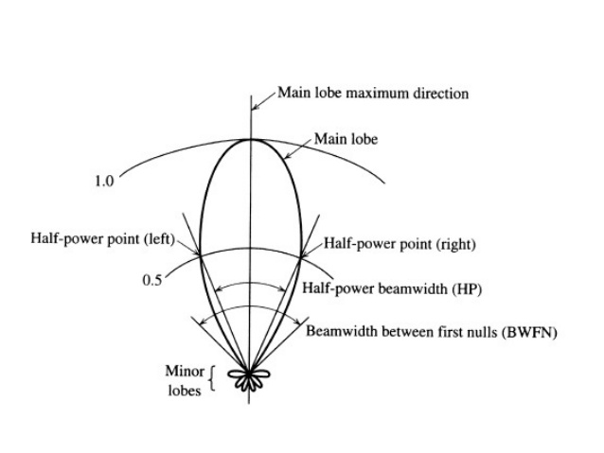

Slide 22
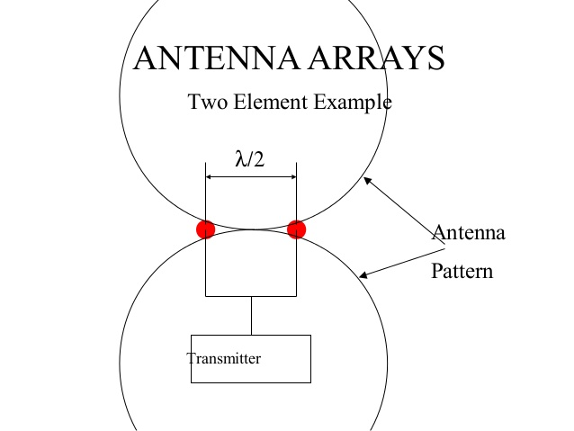

Slide 23
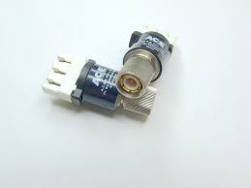
BALLON
A balun (from "balanced to unbalanced") is an electrical device that converts between a balanced signal and an unbalanced signal. ... Common-mode chokes are also used as baluns and work by eliminating, rather than ignoring, common mode signals.

Slide 24
02
TYPES OF ANTENNAS

Slide 25
TO DISCUSS
Folded Dipole, Yagi Antenna. Frequency Independent Antenna. Log Periodic Dipole array. Secondary Sources and Aperture Antennas . Magnetic Current. Principles of Images. The Equivalence Theorem .
Radiation form Huygen’s Sources. Radiation from open end of a Coaxial line. Aperture in an absorbing screen. Radiation through an aperture in a perfectly conducting screen.
Babinet’s Principle– Complementary Screen. A thin slot in an infinite Screen. Slot antenna on a rectangular wave guide wall .

Slide 29
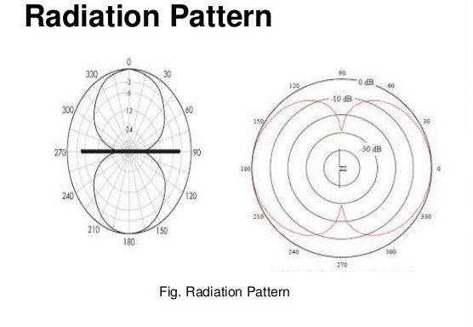

Slide 33
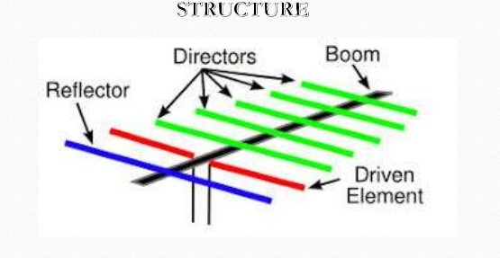

Slide 36
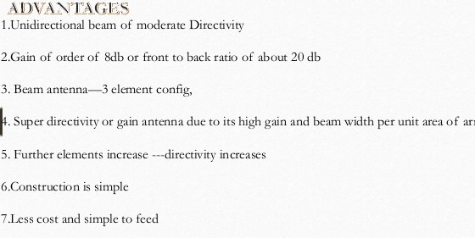

Slide 42
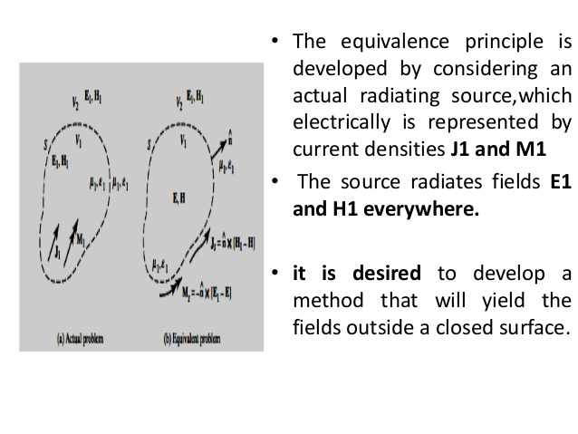

Slide 43
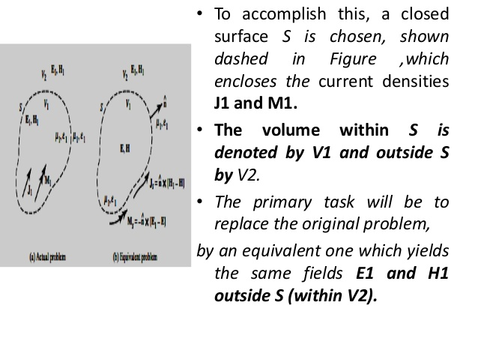

Slide 45
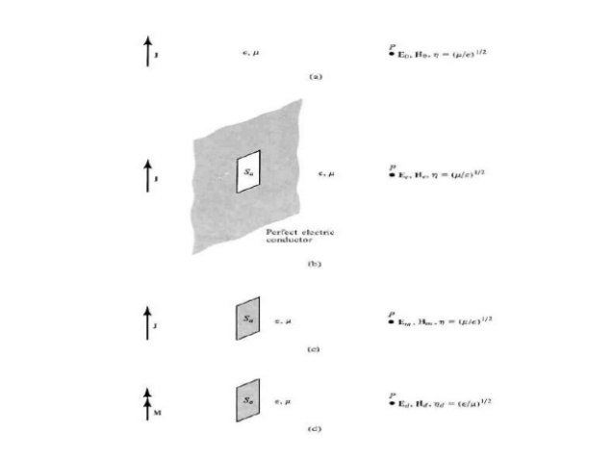

Slide 48
03
HORN ANTENNA

Slide 49
TO DISCUSS
Horn Antennas – Pyramidal &Sectoral Horn. Radiation Pattern and Gain of horn antenna. Parabolic Reflector Antenna Principle, analysis, Radiation Pattern and Gain.
Principles of Casse grain Antenna.
Inducted EMF method of Calculating Input Impedance of wire antenna. Mutual Impedance between two dipoles.

Slide 50
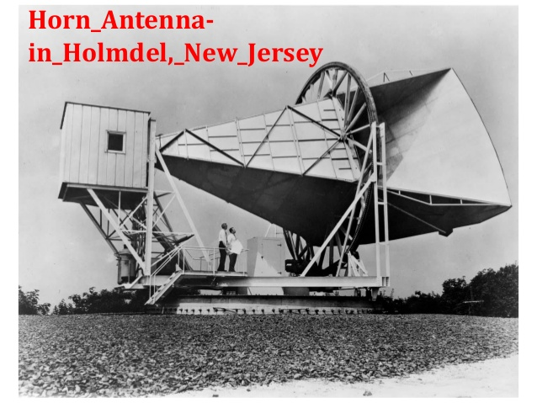

Slide 56
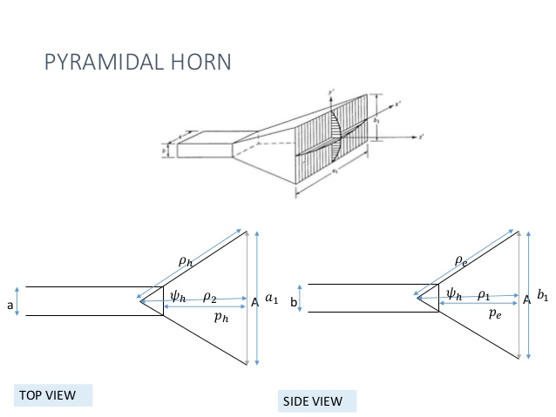

Slide 59
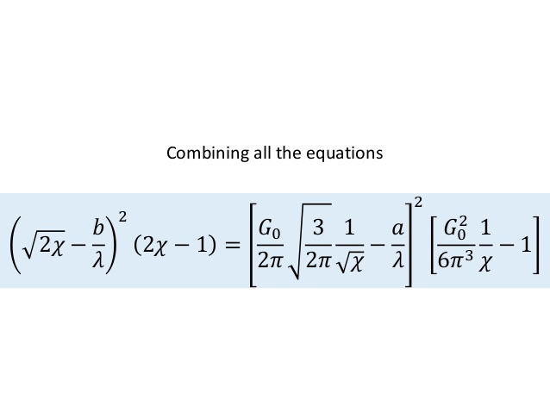

Slide 60
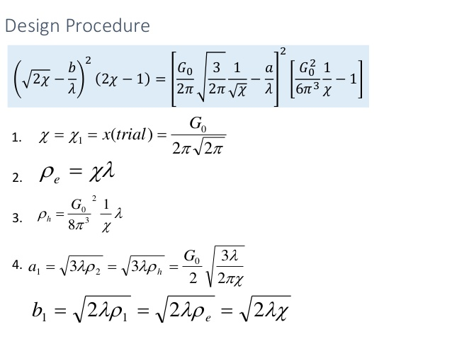

Slide 66
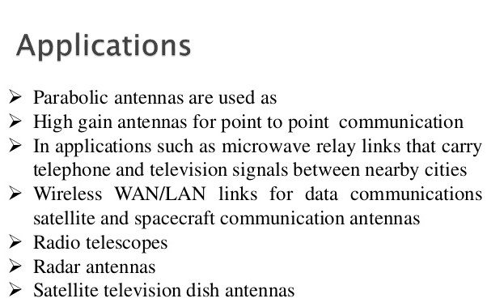

Slide 67
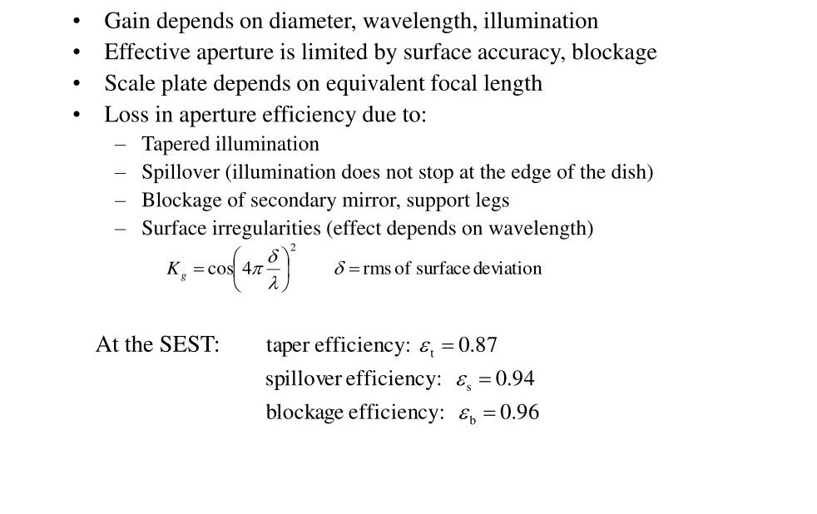
CASSEGRAIN ANTENNA

Slide 68
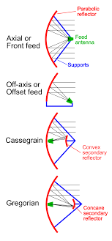

Slide 69
OPERATION OF CASSEGRAIN ANTENNA

Slide 70
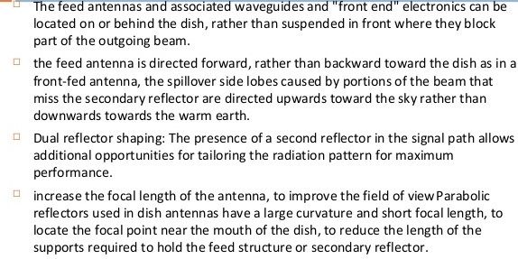
ADVANTAGES OF CASSEGRAIN ANTENNA

Slide 75
04
MICROSTRIP ANTENNA

Slide 76
TO DISCUSS
Microstrip Antenna – Basic Characteristics, Rectangular Patch, Circular Patch, Microship Array Antenna.
Electronic Scanning Antenna- Phase Scanning, Frequency Scanning and Beam switching Antenna Measurements – Radiation Pattern, Gain and Input Impedance..
5G ANTENNA.

Slide 77
MICROSTRIP PATCH ANTENNA

Slide 78
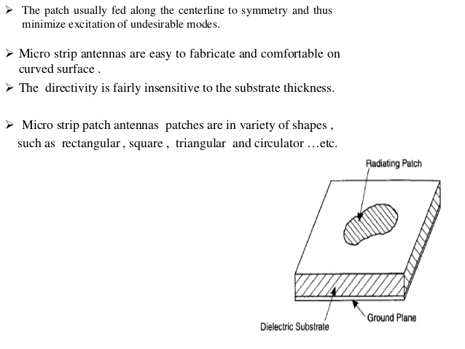

Slide 79
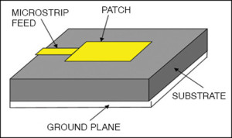

Slide 82
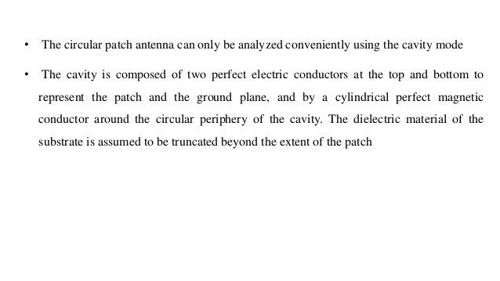

Slide 84
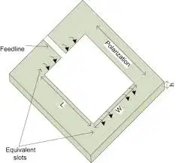
RECTANGULAR PATCH ANTENNA
A rectangular micros trip patch antenna is a form of antenna which consists of a rectangular patch. This patch is of any planar or non-planar geometry on one side of dielectric substrate and a ground plane on the other side. ... The rectangular patch can be easily analysed using transmission line model and cavity model

Slide 85
.
Rectangular Patch Antenna with Strip Feed. Microstrip line feed is one of the easier methods to fabricate as it is a just conducting strip connecting to the patch and therefore can be consider as extension of patch. It is simple to model and easy to match by controlling the inset position.

Slide 89
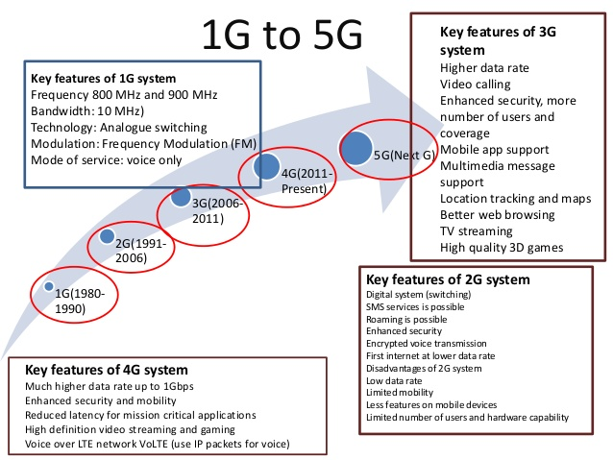
5G ANTENNA

